Slide 1




INNOMATICS RESEARCH LABS
EV DATABASE
WEB SCRAPING PRESENTATION

Slide 2


INTRODUCTION
Electric Vehicles are becoming central to sustainable transport as battery technology, charging infrastructure, and government support drive rapid global adoption.
EVs vary widely in battery size, driving range, safety ratings, charging speed, towing ability, and pricing across international markets.
These differences impact customer decisions, product design for manufacturers, and policy development for governments supporting EV ecosystems.
This project uses Exploratory Data Analysis (EDA) to study global EV data, uncovering patterns and relationships that explain pricing, performance, and market segmentation.

Slide 3

PROBLEM STATEMENT
The rapid expansion of the EV market has created wide variations in pricing, battery capacity, safety ratings, charging features, and performance across countries.
These differences make it difficult for buyers to choose, manufacturers to analyze competition, and policymakers to support EV adoption effectively.
There is limited clarity on how technical factors like battery size, range, and safety impact the final market price and consumer value.
This project analyzes global EV data to identify the key attributes that influence pricing, performance, and segment positioning in the international market.

Slide 4

OBJECTIVES
Analyze EV specifications, pricing, and technical variations across countries to understand market differences.
Compare vehicles by seat category, safety rating, charging capability, and study how battery capacity affects real driving range.
Identify price trends by safety category (Germany, Netherlands, UK) and determine the most/least expensive EV brands.
Evaluate performance factors like acceleration vs weight, towing/cargo capacity, and provide recommendations for customers, manufacturers, and policymakers.

Slide 5






TOOLS USED

Slide 6
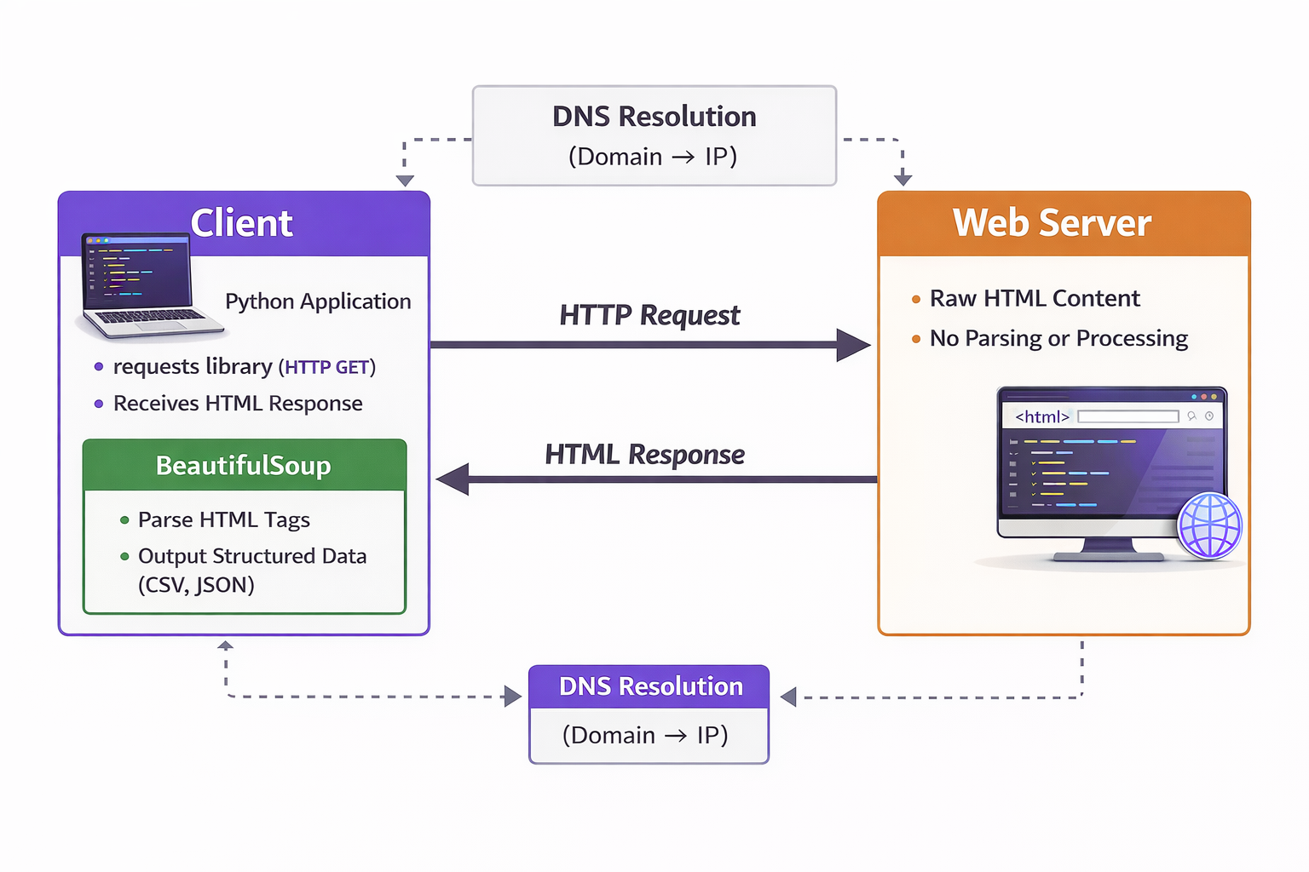
CLIENT-SERVER FLOW CHART

Slide 7
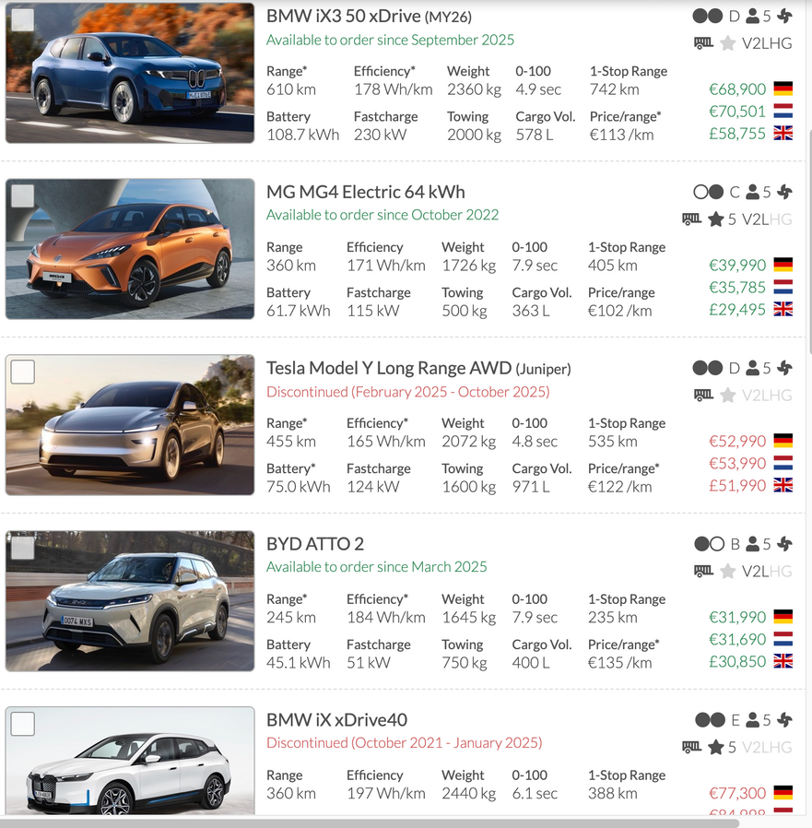

WEB SCRAPPING
Used an EV comparison website as the data source and identified required HTML data using browser Inspect Element.
Followed the Client–Server architecture, where the client (Python script) sent HTTP requests and the server responded with webpage data.
Extracted EV model details (range, efficiency, battery, price, performance) using Requests + BeautifulSoup, then cleaned and stored in Pandas.
Performed EDA to compare price–range value, efficiency trends, and performance insights across electric vehicle models.

Slide 8
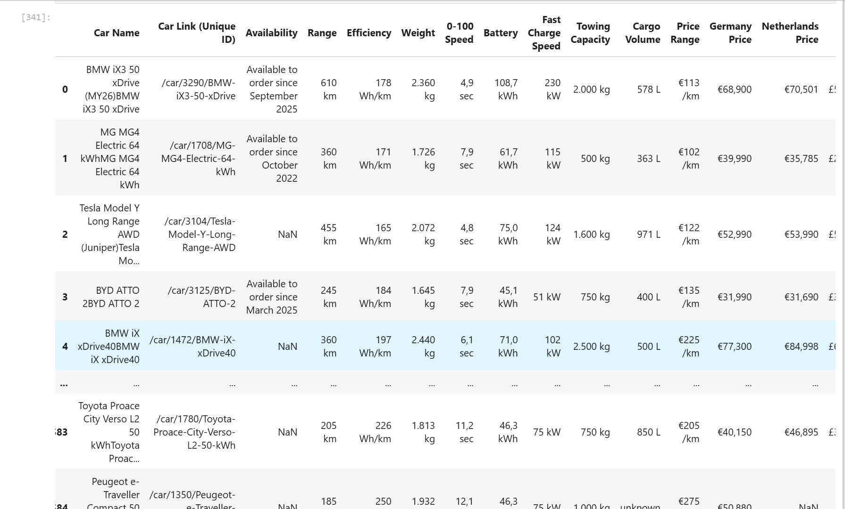
DATASET

Slide 9

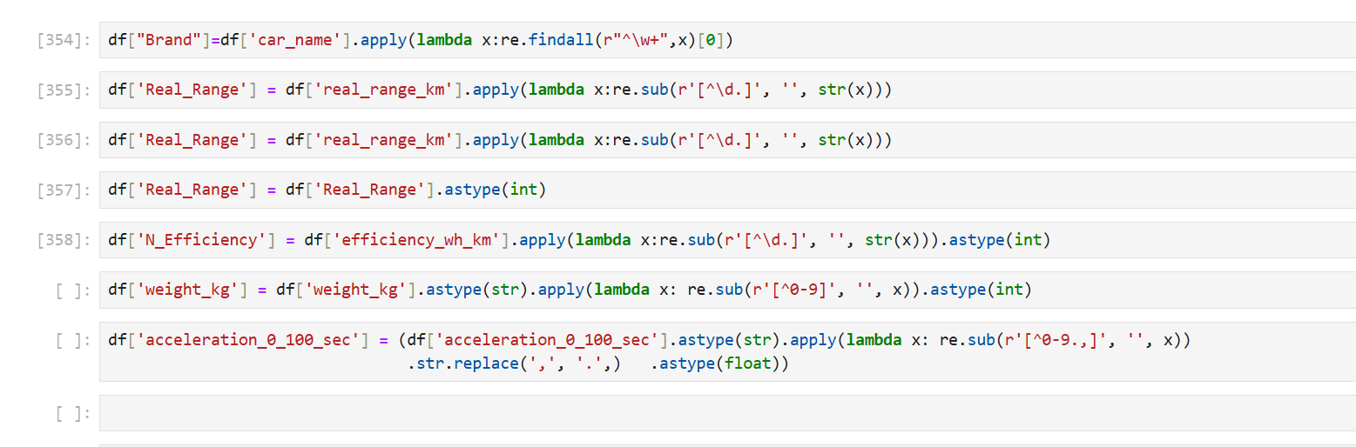

DATA CLEANING - REGEX

Slide 10
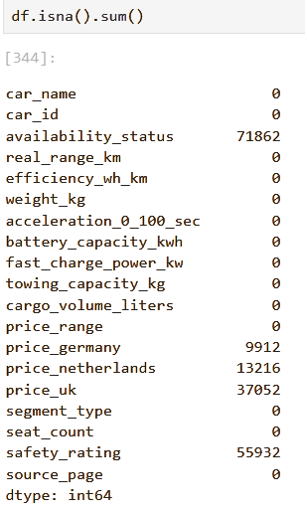
DATA CLEANING STEPS
• Availability status has the highest missing values, indicating incomplete market availability data.
• Price fields (UK, Germany, Netherlands) contain notable gaps, which may affect price comparisons.
• Safety rating also has many missing values, so analysis involving safety should handle nulls carefully.

Slide 11
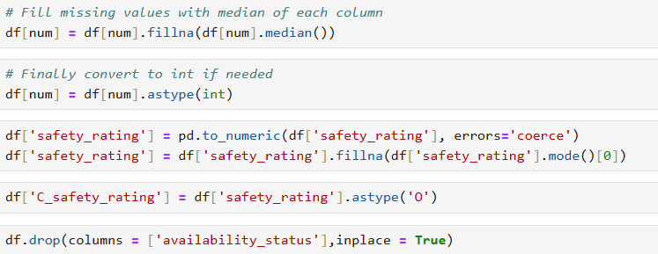
HANDLING NULL VALUES
• Missing numerical values were imputed using median, reducing the impact of outliers.
• Safety rating was cleaned, converted, and filled with the most frequent value to maintain consistency.
• Availability status was removed, simplifying the dataset for further analysis.

Slide 12
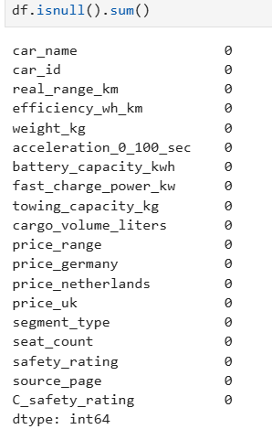

CHECKING NULL VALUES & DUPLICATE ROWS AFTER PREPROCESSING
• The dataset has no missing values across all features, ensuring high data quality.
• This allows direct analysis and modeling without the need for null value treatment.
• Results and insights derived will be more reliable and consistent due to complete data.
• No duplicate records are present in the dataset.
• This confirms each car entry is unique and reliable.
• Duplicate handling is not required before analysis.

Slide 13
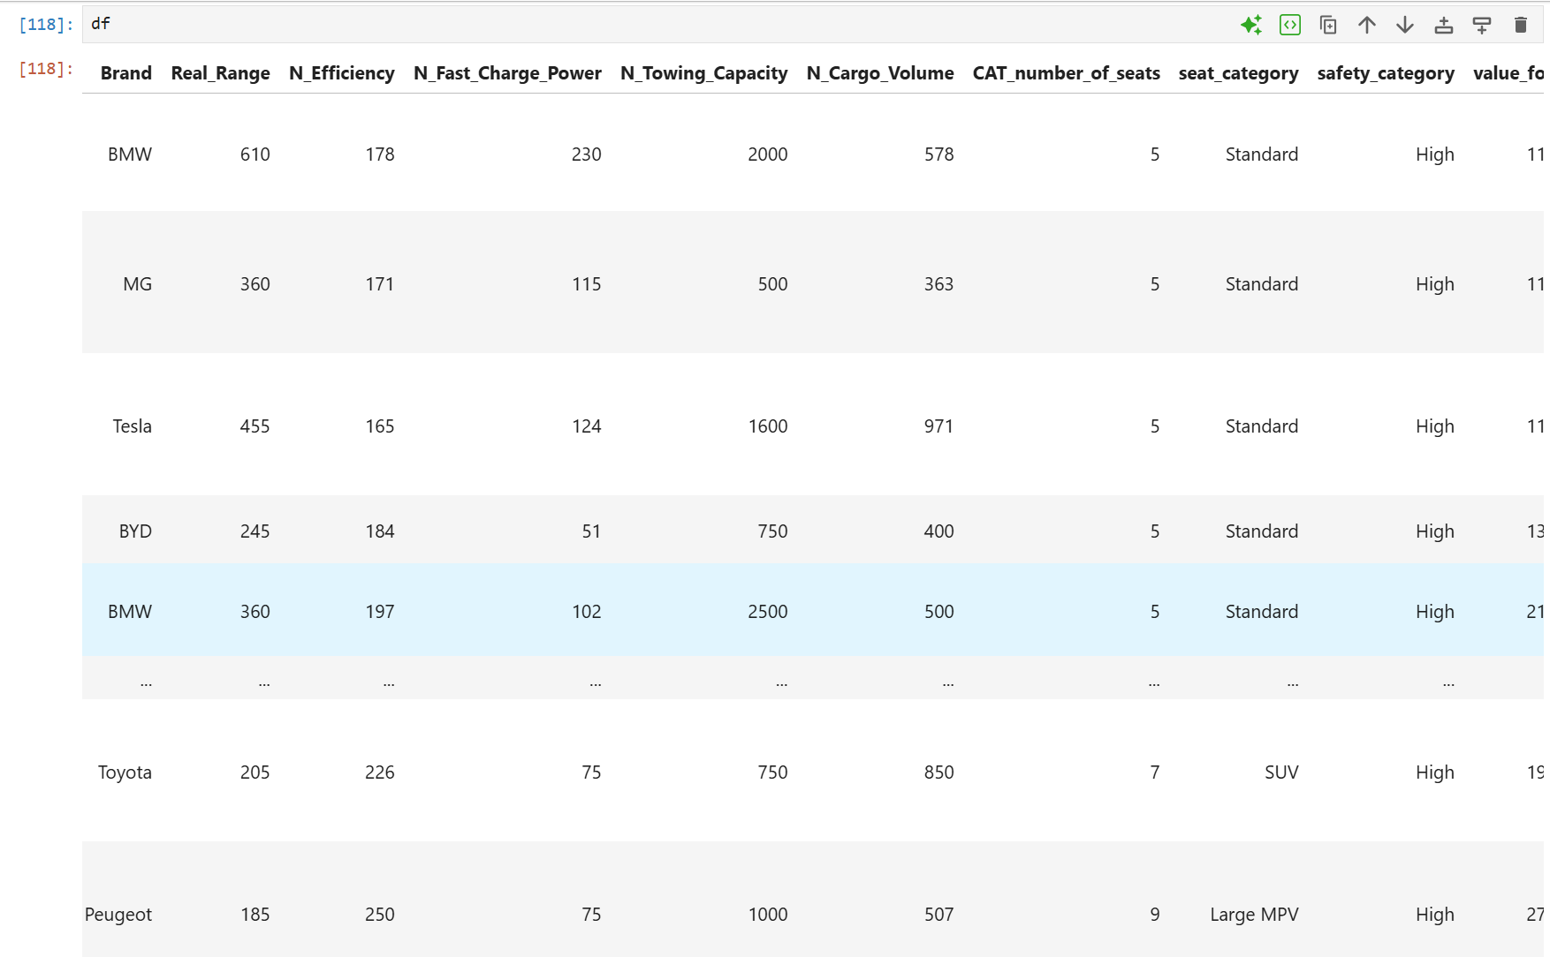
CLEANED DATASET

Slide 14
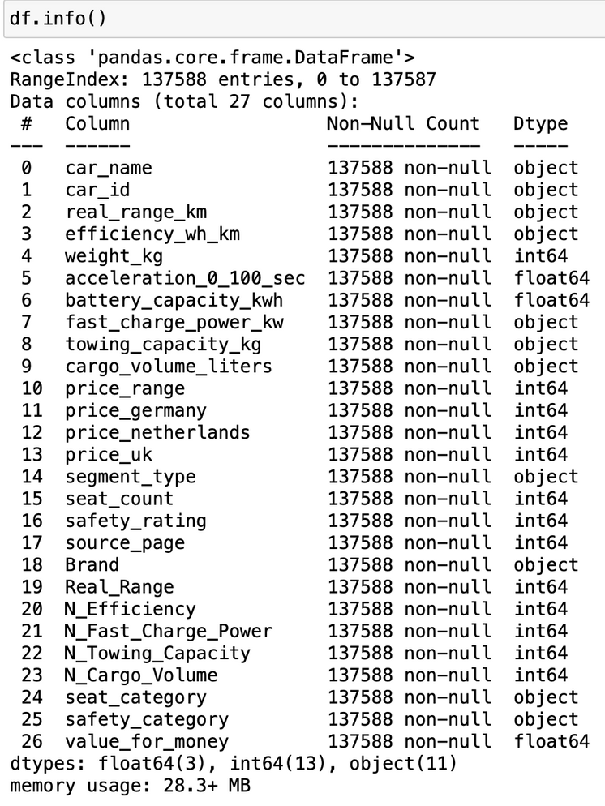
CHECK DATA STRUCTURE
Segment_type, Brand, Seat_category, Safety_category
Describe the car’s type, manufacturer, seating capacity, and safety level.
Real_Range, N_Efficiency, N_Fast_Charge_Power
Describe how far the EV travels, how efficiently it uses energy, and how fast it can charge.
N_Towing_Capacity,N_Cargo_Volume,value_for_money
Describe how much it can tow, storage space available, and overall worth compared to price and features.

Slide 15
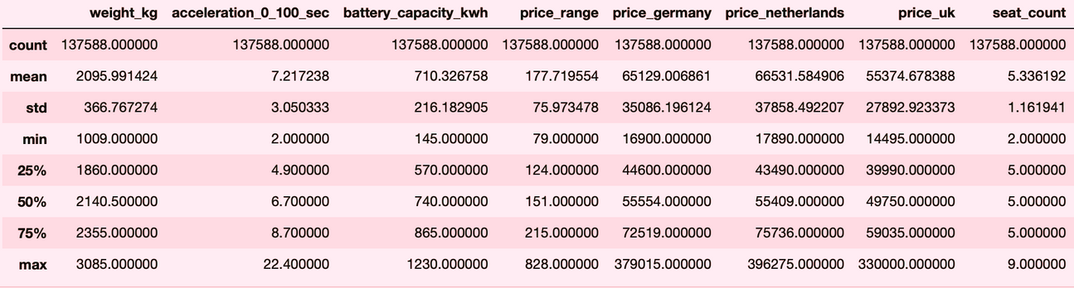
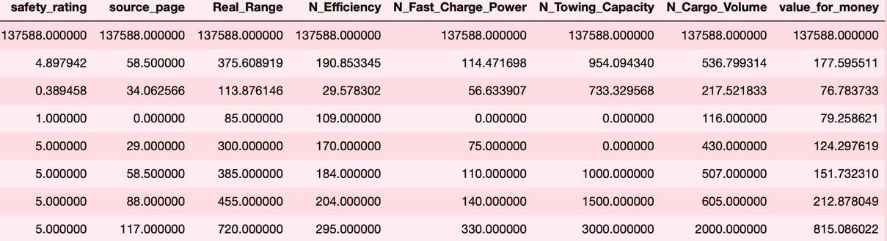
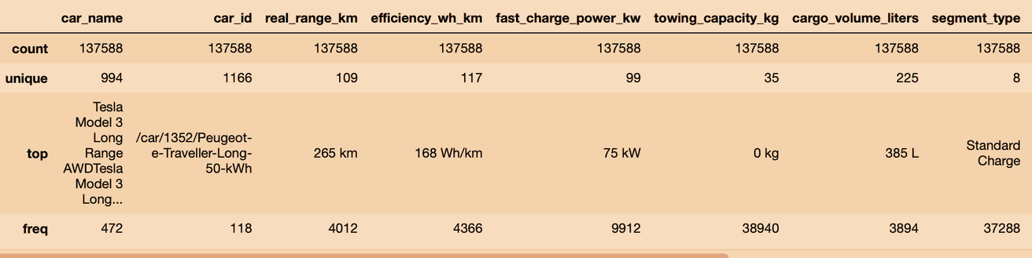
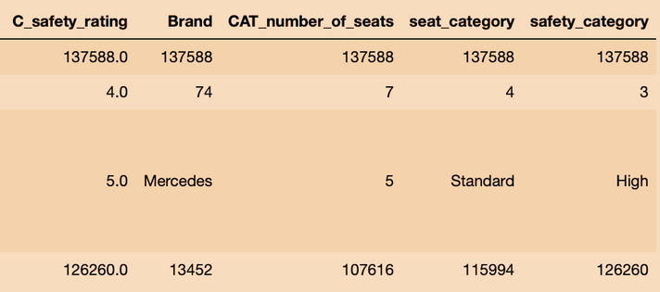
STATISTICAL SUMMARY
NUMERICAL DATA
CATEGORICAL DATA

Slide 16
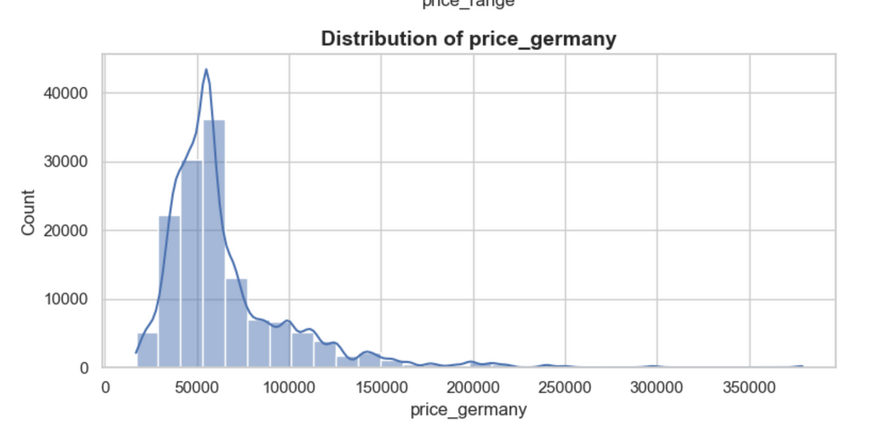
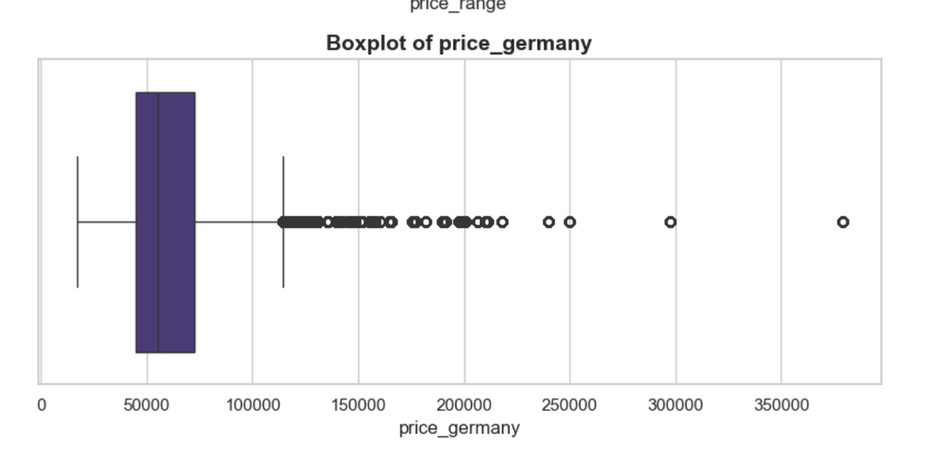
PRICE COMPARISON ACROSS COUNTRIES
Most EVs in Germany are priced between €30,000 and €70,000, showing that the market is concentrated in the mid‑range segment.
The right‑skewed shape and boxplot outliers indicate a small number of premium/luxury EVs above €150,000–€350,000, pulling the average upward.
The presence of many outliers suggests high price variation, meaning Germany has both budget‑friendly and high‑end EV options, making the market diverse in affordability.

Slide 17
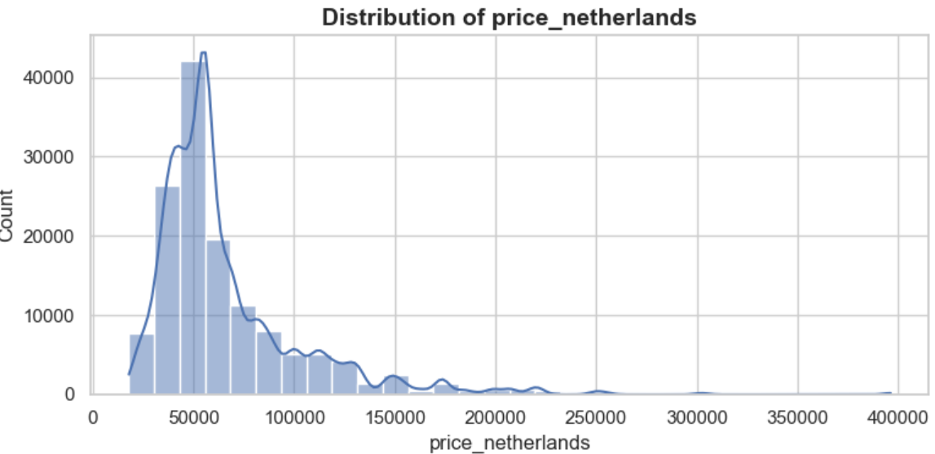
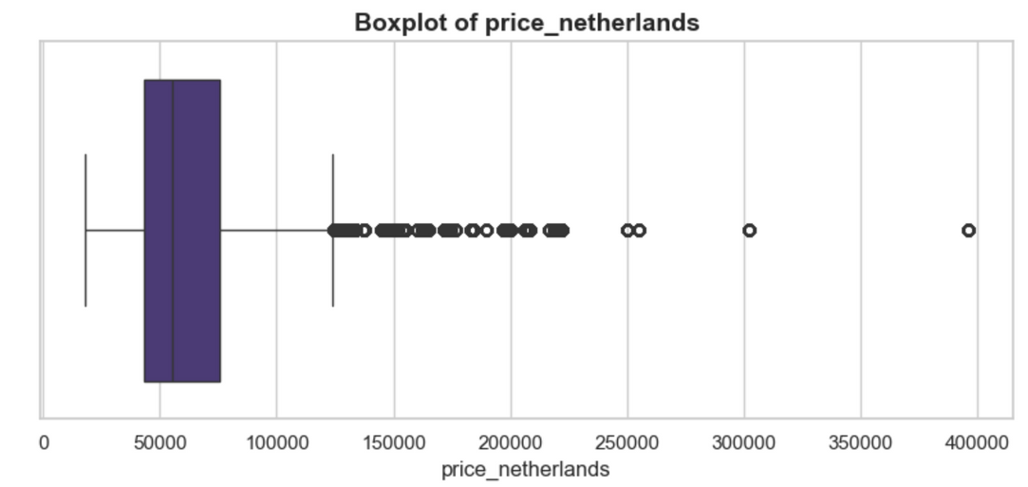
PRICE COMPARISON ACROSS COUNTRIES
Most EVs in the Netherlands are priced around €40,000–€70,000, showing a strong mid‑range market similar to Germany.
The distribution is right‑skewed, with several luxury EVs reaching up to €300,000–€400,000, which causes many outliers on the boxplot.
The wide price spread and heavy presence of outliers suggest a mixed market—from affordable compact EVs to high‑end premium models.

Slide 18
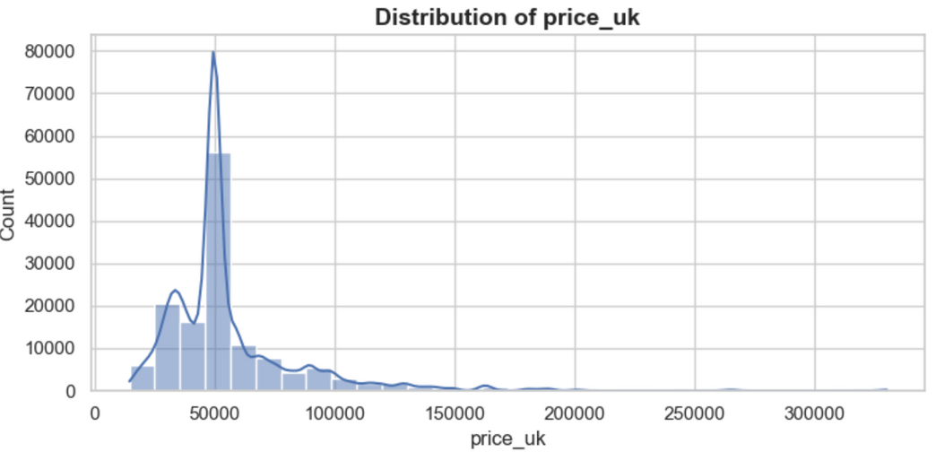
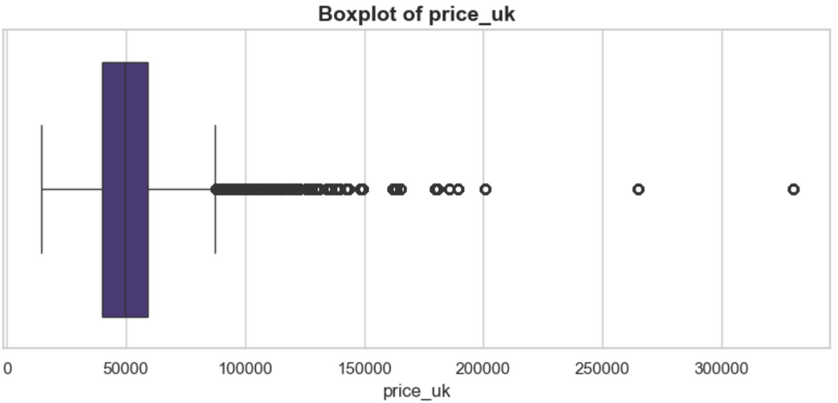
PRICE COMPARISON ACROSS COUNTRIES
Most EVs in the UK fall within the £35,000–£60,000 range, indicating that the UK market leans toward more affordable EV options compared to Germany and the Netherlands.
A strong right‑skew and several outliers show the presence of high‑end luxury EVs up to ~£300,000, but they are very limited in number.
The narrower spread and lower median price suggest the UK market is more cost‑focused, making it a competitive and budget‑friendly EV environment.

Slide 19
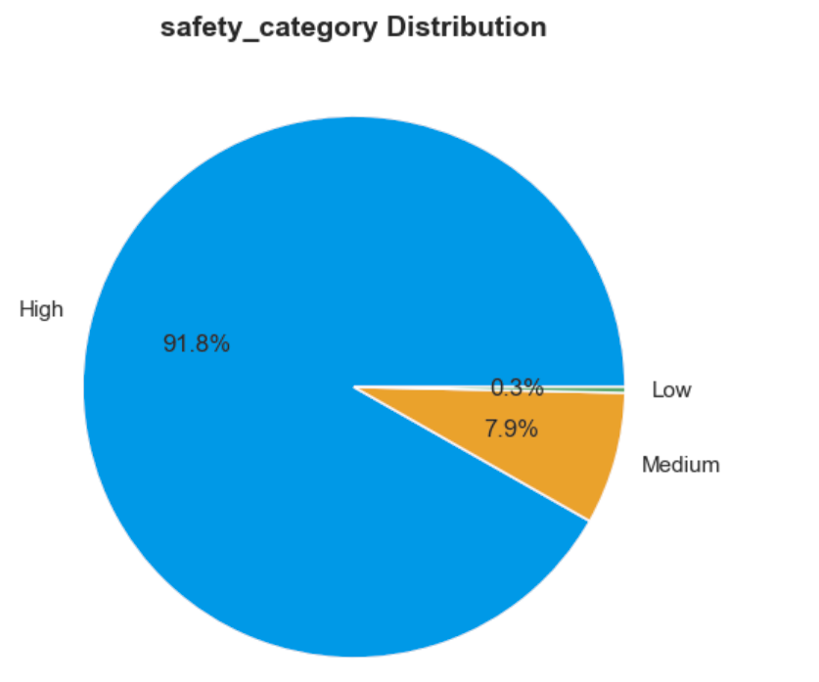
SAFETY CATEGORY
A large majority of EVs (91.8%) fall under the High Safety category, showing that most modern EV models prioritize strong safety standards.
Only 7.9% of vehicles are in the Medium category, indicating fewer models compromise on safety or belong to older/compact segments.
The Low Safety segment is extremely small (0.3%), which suggests that low‑rated EVs are nearly phased out or not competitive in the current market.

Slide 20
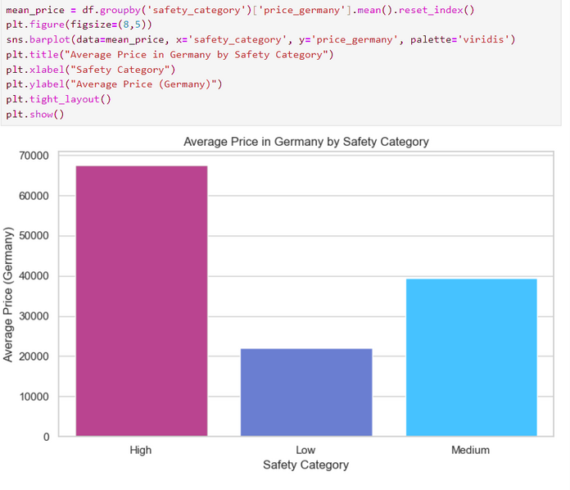
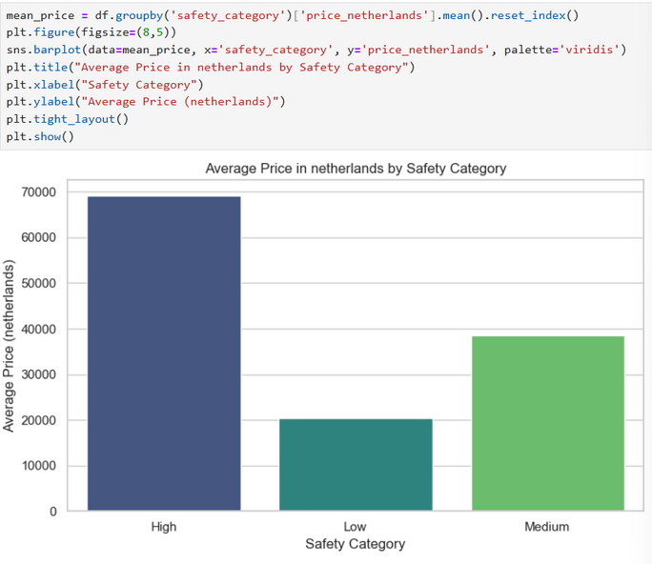
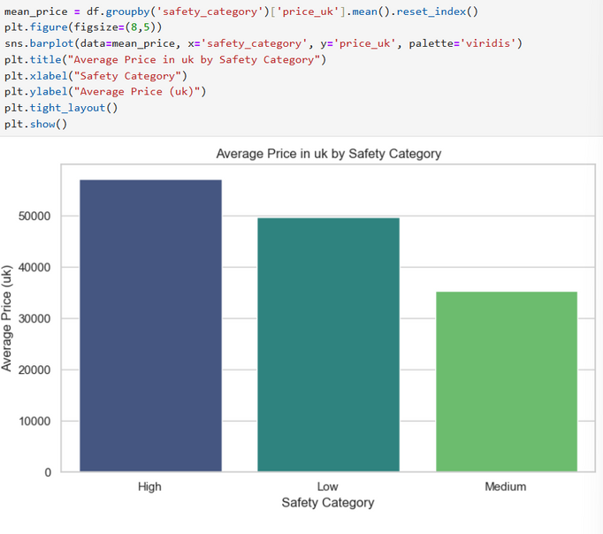
PRICE VS SAFETY CATEGORY (BY COUNTRY)
• High safety vehicles have the highest average price in the German market.
• Low safety models are significantly cheaper, showing a strong price difference.
• This suggests higher safety ratings strongly influence vehicle pricing in Germany.
• High safety vehicles are the most expensive in the Netherlands by a large margin.
• Low safety category has the lowest average price, showing a clear price gap.
• This indicates strong willingness to pay for higher safety standards in the Netherlands.
• Vehicles in the High safety category have the highest average price in the UK.
• Medium safety vehicles are the most affordable, priced much lower than High and Low categories.
• This shows a clear positive relationship between safety level and vehicle price.

Slide 21
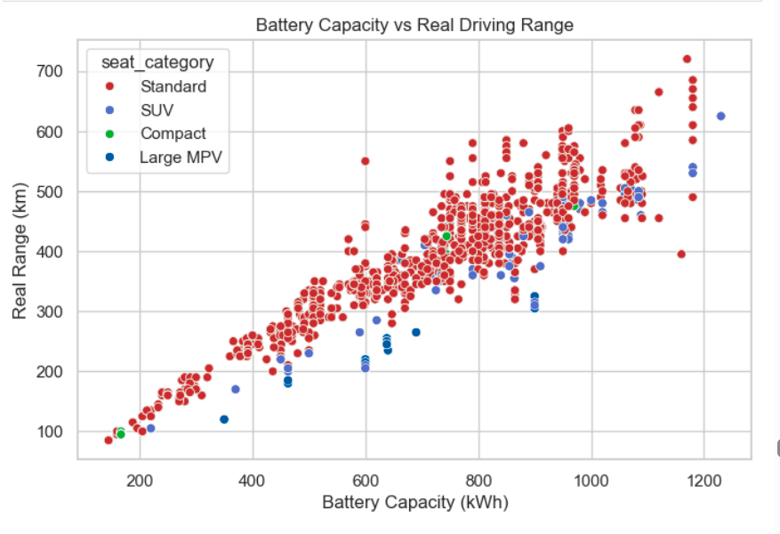
BATTERY CAPACITY VS REAL RANGE (SCATTER)
Battery capacity and real driving range show a strong positive relationship across all vehicle types.
Standard cars dominate the dataset and generally achieve higher range for similar battery sizes.
UVs and Large MPVs tend to deliver slightly lower range, likely due to higher weight and size.

Slide 22
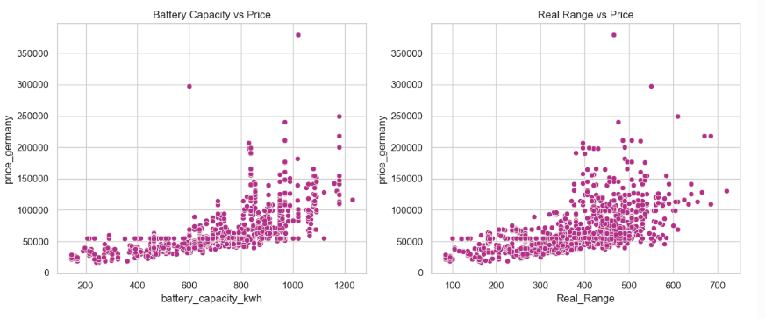
BATTERY CAPACITY / RANGE VS PRICE (SCATTER)
Higher battery capacity is associated with higher vehicle prices, showing a clear upward trend.
Cars with longer real-world range tend to cost more, indicating range is a key pricing factor.
Price variability increases at higher capacity and range, suggesting premium models dominate the upper end.

Slide 23
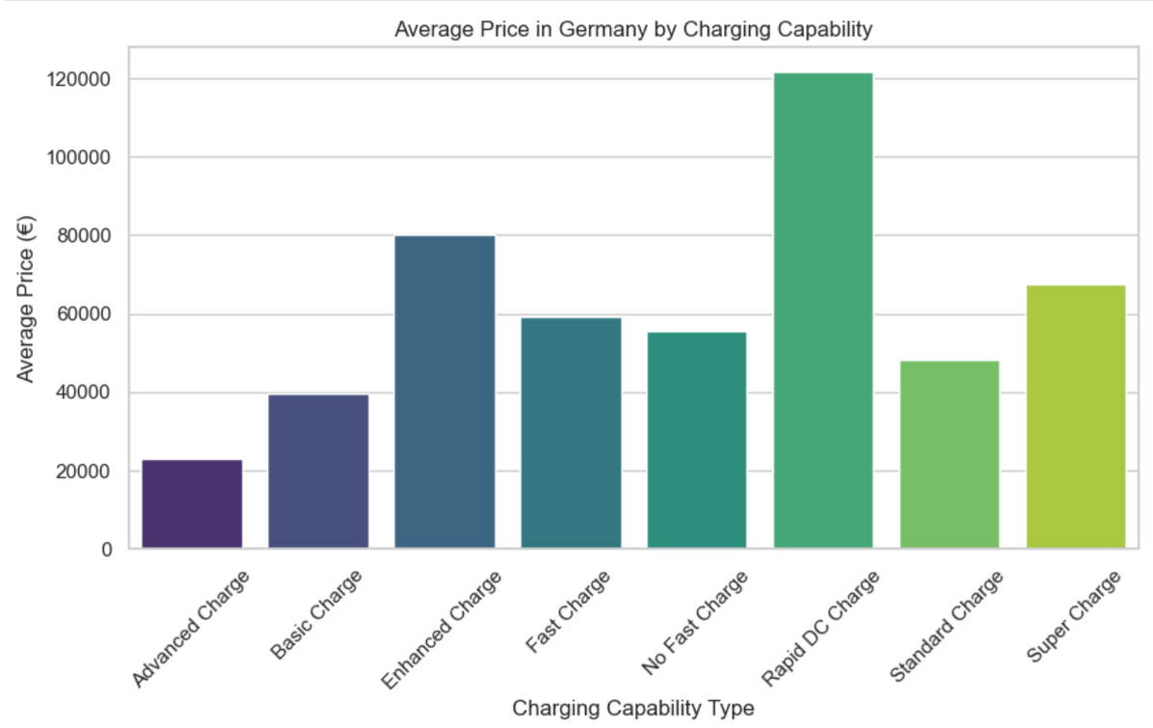
CHARGING TYPE VS PRICE
EVs with Rapid DC Charge have the highest average price, showing that fast‑charging technology is mainly offered in premium and high‑performance models.
Advanced/Basic/Standard Charge vehicles are priced much lower, indicating these features are common in budget or mid‑range EVs.
Price generally increases as charging capability improves, meaning charging speed is a strong indicator of the vehicle’s segment and technology level.

Slide 24
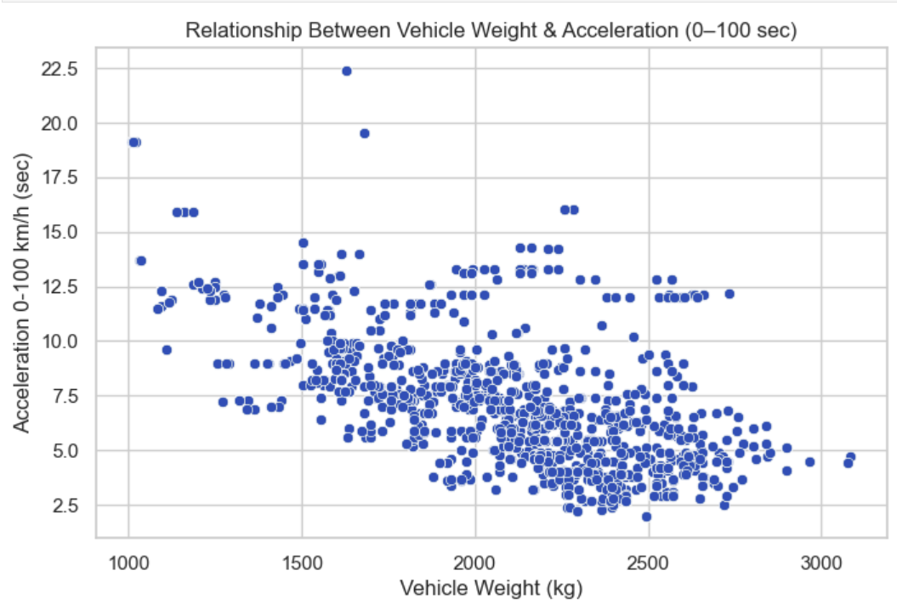
ACCELERATION VS VEHICLE WEIGHT
Heavier vehicles generally accelerate faster (lower 0–100 sec), showing a negative relationship.
This suggests powerful motors in heavier EVs offset the extra weight.
Lighter vehicles show wider variation in acceleration performance.

Slide 25
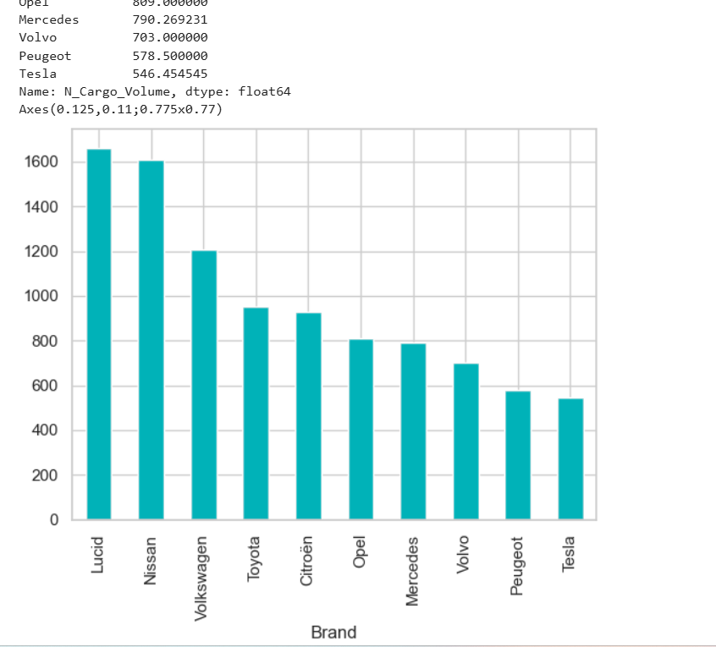
TOP BRANDS BY CARGO CAPACITY
Lucid and Nissan lead the chart with the highest values, showing strong performance compared to other brands.
Volkswagen, Toyota, and Citroën form a solid middle tier with moderate but competitive figures.
Tesla and Peugeot are at the lower end, indicating comparatively smaller values in this dataset.

Slide 26

CONCLUSION
This project shows that the global EV market has wide variation in price, battery capacity, safety ratings, charging speed, and performance across countries. The analysis proves that higher safety ratings, larger battery capacity, and advanced charging technology are key factors that increase the vehicle price, while the UK market shows comparatively more budget‑friendly pricing than Germany and the Netherlands. A strong positive link between battery size and driving range highlights the importance of battery technology in real‑world EV performance. Overall, the study helps buyers understand value, manufacturers improve product positioning, and policymakers support affordable and safe EV adoption.

Slide 27
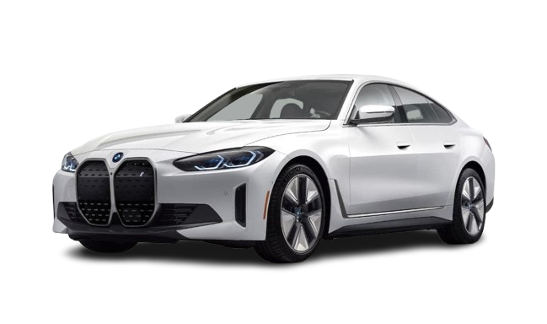
EXPERIENCES & CHALLENGES
During web scraping, handling inconsistent website structures, missing data fields loading created difficulties in extracting clean and uniform information.
Data preprocessing took time due to duplicate entries, null values, unit differences (€, £), and noise, requiring careful cleaning, normalization, and feature engineering before analysis.
Visualizing multi‑country pricing and performance comparisons was challenging, but using the right plots (scatter, boxplots, correlation maps) helped uncover clear insights and patterns.
Understanding relationships like battery ↔ range and safety ↔ price taught the importance of choosing meaningful metrics and validating assumptions with data rather than guessing.

Slide 28

THANK YOU
FOR YOUR ATTENTION
PRESENTED BY:
JAKKOJU VIKAS RAJ
CHALLA RISHITHA
PRANAVI BANDARU

